Slide 1

Schizophrenia Awareness: Let's Change Perspectives
Swipe to learn and spread awareness!

Slide 2
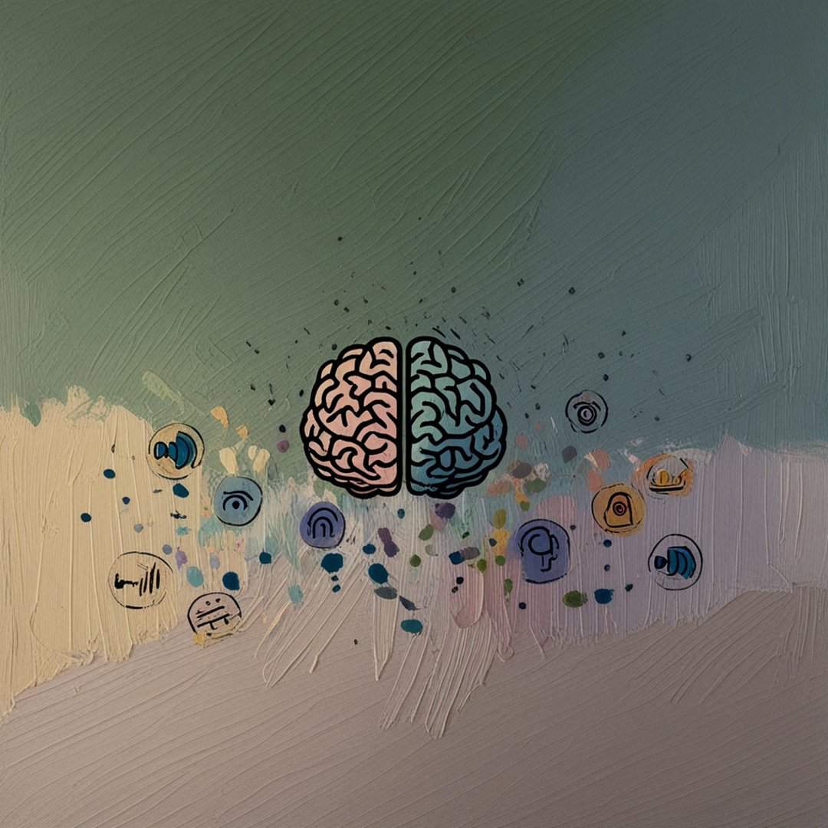
Schizophrenia is a serious mental health condition that affects how a person thinks, feels, and behaves.
It’s not a split personality—it’s a disorder of reality

Slide 3

Can You Spot the symptoms?

Slide 4
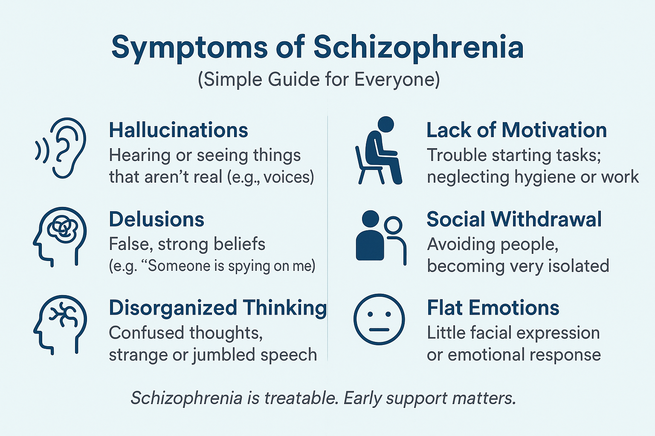

Slide 5

Schizophrenia Affects Everyone Equally
No one is immune here

Slide 6

Is There Hope?
YES!

Slide 7

early diagnosis, medications, and therapy, people with schizophrenia can live stable and fulfilling lives.
Support and understanding make a huge difference!

Slide 8

Break the Stigma Today, Let's Talk

Slide 9
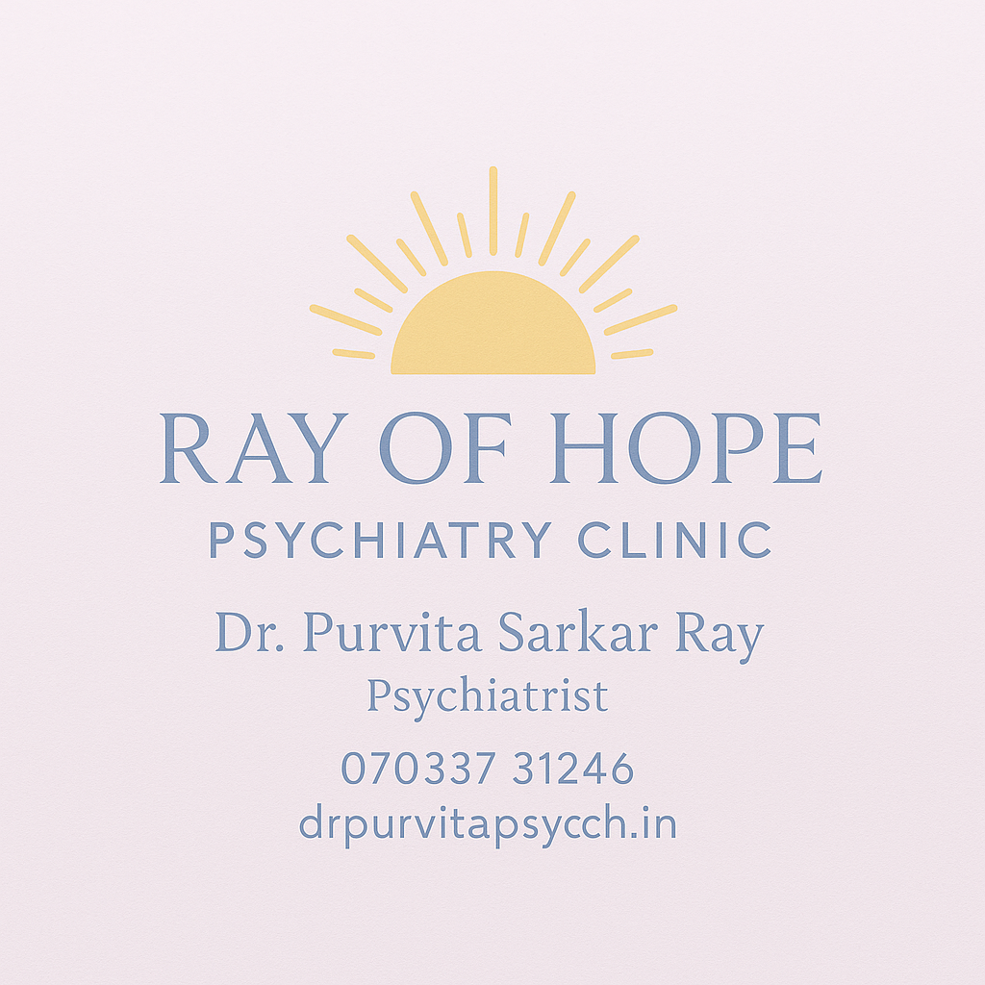
drpurvitapsych.in

